Slide 2
Objectives
Construct truth tables for the following logic gates:
NOT, AND, OR
NAND, NOR
XOR (EOR)
Create logic circuits from problem statements, logic expressions or truth tables
Complete truth tables from problem statements, logic expressions or logic circuit
Write logic expressions from problem statements, logic circuits or truth tables

Slide 3
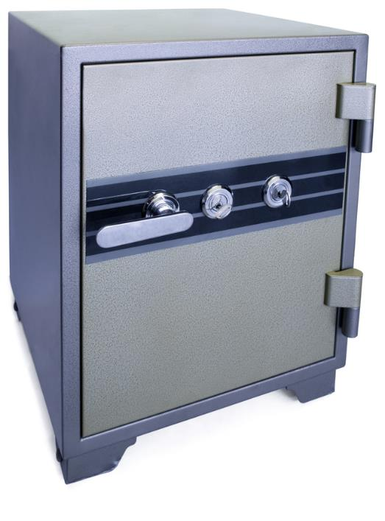
Starter
Consider a safe with two keys
If both keys are used, the safe opens
IF key1 AND key2 THEN safeOpen ← TRUE
ELSE safeOpen ← FALSE ENDIF
What are the only possible values that key1 and key2 can be?
What values must they be to open the safe?

Slide 4
Starter
IF key1 AND key2 THEN safeOpen ← TRUE
ELSE safeOpen ← FALSE ENDIF
What are the only possible values that key1 and key2 can be?
Key1 and key2 can only be TRUE or FALSE (lock or unlock)
What values must they be to open the safe?
They must both be TRUE to open the safe

Slide 5
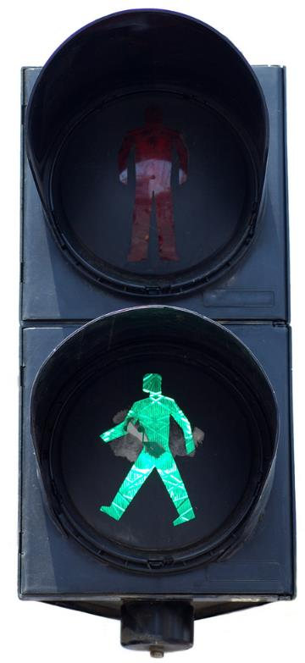
Binary situations
Binary situations are common in daily life and can refer to things that can be in only one of two states:
Stop or Go
Pass or Fail
On or Off
In computing terms
A binary 1 can represent TRUE
A binary 0 can represent FALSE

Slide 6
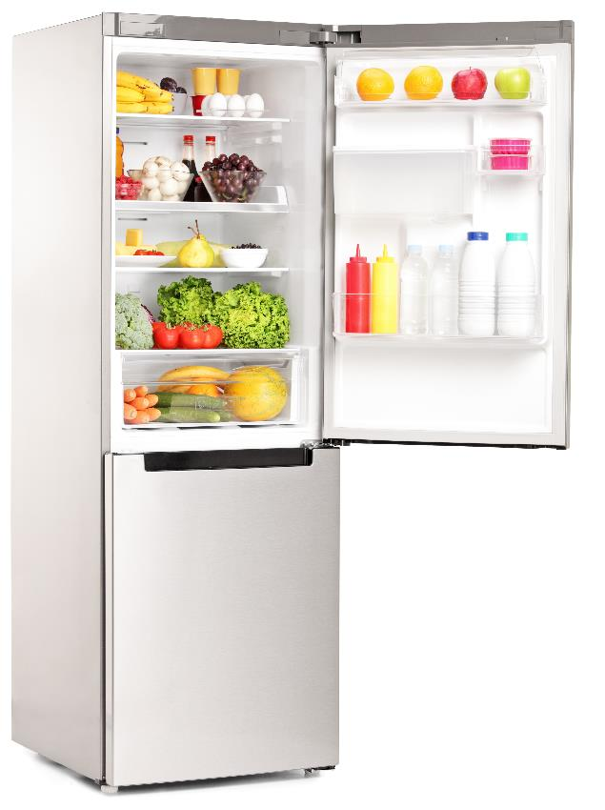
Booleans in loops
Booleans used in IF statements and loops
WHILE doorOpen turnOnLight() ENDWHILE

Slide 7

True or False?
Unlocking a smartphone:
using a known fingerprint or
using a correct PIN code?
IF fingerprint OR correctPIN THEN unlock ← TRUE
ELSE unlock ← FALSE

Slide 8
Boolean functions
AND, OR and NOT are Boolean operators
A computer can calculate the results of A AND B, A OR B, or NOT A
What do these two circuit diagrams represent?
Input
Output
A
B
A
Input
Output
B

Slide 9
Boolean functions
What do these two circuit diagrams represent?
AND Both switches must be down to complete the circuit
Input
Output
A
B
A
OR Either switch needs to be down to complete the circuit
Input
Output
B

Slide 10
Truth tables
A truth table shows the output from all possible combinations of inputs from a Boolean expression
If there are two inputs A AND B, there are four possible combinations of TRUE and FALSE
Both A and B must be True for the output to be True
Input A | Input B | A AND B
False | False | False
False | True | False
True | False | False
True | True | True

Slide 11
Boolean function – AND
It is also possible to use 1 and 0 to represent True and False
The below truth tables represent: IF a lift is on the correct floor AND the call button has been pressed THEN open the lift door
What are the values for Open Lift Door and P below?
Lift on correct floor | Button Pressed | Open Lift Door
False | False | ?
False | True | ?
True | False | ?
True | True | ?
A | B | P
0 | 0 | ?
0 | 1 | ?
1 | 0 | ?
1 | 1 | ?

Slide 12

Truth table – AND
IF both inputs are TRUE then the output is TRUE
Lift on correct floor | Button Pressed | Open Lift Door
0 | 0 | 0
0 | 1 | 0
1 | 0 | 0
1 | 1 | 1
A | B | P
0 | 0 | 0
0 | 1 | 0
1 | 0 | 0
1 | 1 | 1

Slide 13


Boolean function – OR
IF lane1Open OR lane2Open
If lane one is open OR lane 2 is open then you can drive down the road
What is P?
lane1 Open | Lane2 Open | P
False | False | ?
False | True | ?
True | False | ?
True | True | ?
A | B | P
0 | 0 | ?
0 | 1 | ?
1 | 0 | ?
1 | 1 | ?

Slide 14
Boolean function – OR
IF lane1Open OR lane2Open
If lane one is open OR lane 2 is open then you can drive down the road
What is P?
lane1 Open | Lane2 Open | P
False | False | False
False | True | True
True | False | True
True | True | True
A | B | P
0 | 0 | 0
0 | 1 | 1
1 | 0 | 1
1 | 1 | 1

Slide 15
Boolean function – NOT
IF the input is True then the output is False
IF the input is False then the output is True
Input A | Output P = NOT A
False | True
True | False

Slide 16
More logic
Which of the following statements are True?
(4 > 3) AND (5 > 7)
(2 < 8) OR (8 > 10)
NOT (5 * 7 > 30)
((7 DIV 3) >= 2) OR ((7 DIV 3) < 2)
((12 MOD 5) < 2) AND ((12 MOD 5) == 2)
DIV gives the integer division (the result of division without any fractional component)
MOD gives the remainder after a division

Slide 17
More logic
Which of the following statements are True?
(4 > 3) AND (5 > 7) False
(2 < 8) OR (8 > 10) True
NOT (5 * 7 > 30) False
((7 DIV 3) >= 2) OR ((7 DIV 3) < 2) True
((12 MOD 5) < 2) AND ((12 MOD 5) == 2) False

Slide 18
Worksheet 3
Now complete Task 1 on Worksheet 3

Slide 19
From truth tables to logic gates
The following logic gates are used in circuits:
AND gate
OR gate
NOT gate
NAND gate (NOT AND)
NOR gate (NOT OR)
XOR gate (Exclusive OR)

Slide 20
Binary logic – AND gate
If both inputs are 1 (True) then the output is 1 (True)
Otherwise the output is 0 (False)
A | B | P
0 | 0 | ?
0 | 1 | ?
1 | 0 | ?
1 | 1 | ?
INPUT
A
OUTPUT
P
INPUT
B
Logic statement: P = A AND B
Logic Diagram
Truth Table

Slide 21
Binary logic – AND gate
If both inputs are 1 (True) then the output is 1 (True)
Otherwise the output is 0 (False)
A | B | P
0 | 0 | 0
0 | 1 | 0
1 | 0 | 0
1 | 1 | 1
INPUT
A
OUTPUT
P
INPUT
B
Logic statement: P = A AND B
Logic Diagram
Truth Table

Slide 22
Binary logic – OR gate
If either input is 1 (True) then the output is 1 (True)
Otherwise the output is 0 (False)
A | B | P
0 | 0 | ?
0 | 1 | ?
1 | 0 | ?
1 | 1 | ?
INPUT
A
OUTPUT
P
INPUT
B
Logic statement: P = A OR B
Logic Diagram
Truth Table

Slide 23
Binary logic – OR gate
If either input is 1 (True) then the output is 1 (True)
Otherwise the output is 0 (False)
A | B | P
0 | 0 | 0
0 | 1 | 1
1 | 0 | 1
1 | 1 | 1
INPUT
A
OUTPUT
P
INPUT
B
Logic statement: P = A OR B
Logic Diagram
Truth Table

Slide 24
Binary logic – NOT gate
If 0 is input it outputs 1 (True)
If 1 is input it outputs 0 (False)
A | P
0 | ?
1 | ?
INPUT
A
OUTPUT
P
Logic statement: P = NOT A
Logic Diagram
Truth Table

Slide 25
Binary logic – NOT gate
If 0 is input it outputs 1 (True)
If 1 is input it outputs 0 (False)
A | P
0 | 1
1 | 0
INPUT
A
OUTPUT
P
Logic statement: P = NOT A
Logic Diagram
Truth Table

Slide 26
Worksheet 3
Now complete Task 2 on Worksheet 3

Slide 27
NAND, NOR and XOR gates
A NAND gate gives the opposite results to an AND gate
It is the same as combining an AND gate with a NOT gate
In the same way, a NOR gate is the same as combining an OR gate with a NOT gate
An Exclusive OR gate (XOR) will only be true if one of the inputs is true
It will be false if both inputs are true, hence it’s exclusive
Complete the truth tables for NAND, NOR and XOR gates
Also, guess what the symbol would be for each

Slide 28
NAND, NOR and XOR gates
A | B | A NAND B | A NOR B | A XOR B
0 | 0 | 1 | 1 | 0
0 | 1 | 1 | 0 | 1
1 | 0 | 1 | 0 | 1
1 | 1 | 0 | 0 | 0

Slide 29
Worksheet 3
Now complete Task 3 on Worksheet 3

Slide 30
Combining logic gates
We can combine logic gates together to make more complex circuits
INPUT
A
R
OUTPUT
P
INPUT
B
A | B | R = A AND B | P = NOT R
0 | 0
0 | 1
1 | 0
1 | 1
Logic statement:
P = NOT (A AND B)

Slide 31
Combining logic gates
We can combine logic gates together to make more complex circuits
INPUT
A
R
OUTPUT
P
INPUT
B
A | B | R = A AND B | P = NOT R
0 | 0 | 0
0 | 1 | 0
1 | 0 | 0
1 | 1 | 1
Logic statement:
P = NOT (A AND B)

Slide 32
Combining logic gates
We can combine logic gates together to make more complex circuits
INPUT
A
R
OUTPUT
P
INPUT
B
A | B | R = A AND B | P = NOT R
0 | 0 | 0 | 1
0 | 1 | 0 | 1
1 | 0 | 0 | 1
1 | 1 | 1 | 0
Logic statement:
P = NOT (A AND B)

Slide 33
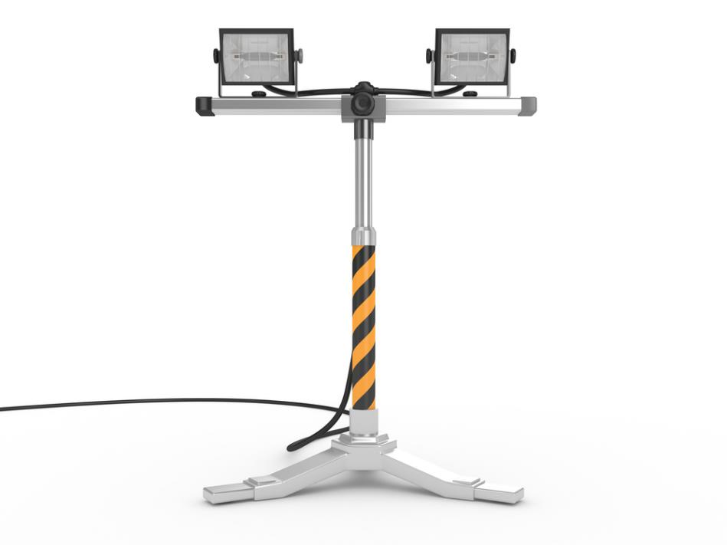

Modelling real life – security lighting
What would the circuit diagram for this situation look like?
The security light must come on if it senses movement AND it is night time, OR if someone presses a manual override switch

Slide 34




Modelling real life
Sensor detects
movement = TRUE
Night time
= TRUE
Manual override
Button = TRUE
Security
Light On
AND
OR
=
Sensor detects
Movement (S)
Night time (N)
Security
Light
Manual override
Button (B)

Slide 35
The truth table
Sensor detects
Movement (S)
OUTPUT
R
Night time (N)
Security
Light (P)
Manual override
Button (B)
S | N | B | R = S AND N | P = R OR B
Logic statement:
P = (S AND N) OR B

Slide 36
The truth table
Sensor detects
Movement (S)
OUTPUT
R
Night time (N)
Security
Light (P)
Manual override
Button (B)
S | N | B | R = S AND N | P = R OR B
0 | 0 | 0
0 | 0 | 1
0 | 1 | 0
0 | 1 | 1
1 | 0 | 0
1 | 0 | 1
1 | 1 | 0
1 | 1 | 1
Logic statement:
P = (S AND N) OR B

Slide 37
The truth table
Sensor detects
Movement (S)
OUTPUT
R
Night time (N)
Security
Light (P)
Manual override
Button (B)
S | N | B | R = S AND N | P = R OR B
0 | 0 | 0 | 0
0 | 0 | 1 | 0
0 | 1 | 0 | 0
0 | 1 | 1 | 0
1 | 0 | 0 | 0
1 | 0 | 1 | 0
1 | 1 | 0 | 1
1 | 1 | 1 | 1
Logic statement:
P = (S AND N) OR B

Slide 38
The truth table
Sensor detects
Movement (S)
OUTPUT
R
Night time (N)
Security
Light (P)
Manual override
Button (B)
S | N | B | R = S AND N | P = R OR B
0 | 0 | 0 | 0 | 0
0 | 0 | 1 | 0 | 1
0 | 1 | 0 | 0 | 0
0 | 1 | 1 | 0 | 1
1 | 0 | 0 | 0 | 0
1 | 0 | 1 | 0 | 1
1 | 1 | 0 | 1 | 1
1 | 1 | 1 | 1 | 1
Logic statement:
P = (S AND N) OR B

Slide 39
Worksheet 3
Now complete Task 4 and Task 5 on Worksheet 3

Slide 40


Plenary
Answer the following questions with a partner:
What are six logic gates?
What are the symbols for each of the logic gates?
What is a truth table?

Slide 41
Plenary
What are six logic gates?
AND, OR, NOT, NAND, NOR, XOR/EOR
What are the symbols for each of the logic gates?
AND OR NOT NAND NOR XOR
What is a truth table?
It shows all possible combinations of inputs and the outputs they create

